Slide 1
SUPERSTORE SALES DATASET ANALYSIS
by Odunola Adewale
http://linkedin.com/in/odunola-adewale-52a4a8158
https://github.com/AnalystOdunola

Slide 2
DATASET OVERVIEW
The analysis uses the Superstore Sales dataset covering retail transactions from 2014–2017 across the four major U.S. regions: Central, East, South and West. The dataset contains 5,009 orders from 793 customers and includes key business metrics such as sales, profit, discounts, quantity sold, and shipping modes. It also captures detailed product and customer information across multiple categories and sub-categories, making it suitable for sales performance and customer behavior analysis. Key dimensions in the dataset include Year, Region, Category, Sub-Category, Product Name, and Customer Name, which support trend analysis, segmentation, and profitability tracking.

Slide 3
BUSINESS PROBLEM
The goal is to understand where the business is making and losing money. Specifically:
Which product categories and sub-categories generate the highest profit and losses.
Which regions contribute the most to overall sales and profitability.
Whether discount strategies are positively or negatively impacting profit margins.
Which customers and products drive the highest revenue performance.
Where the business should focus to improve profitability and operational efficiency.
How sales trends change over time across categories and regions.
What insights can support better strategic and data-driven decision-making.

Slide 4
KPIs DEFINED
Total Sales: $2.30M generated across all transactions.
Total Profit: $286.40K earned after discounts and operational costs.
Profit Margin: 12.47% profit as a % of sales.
Total Customers: 793 unique customers recorded in the dataset.
Total Orders: 5,009 completed customer orders.

Slide 5
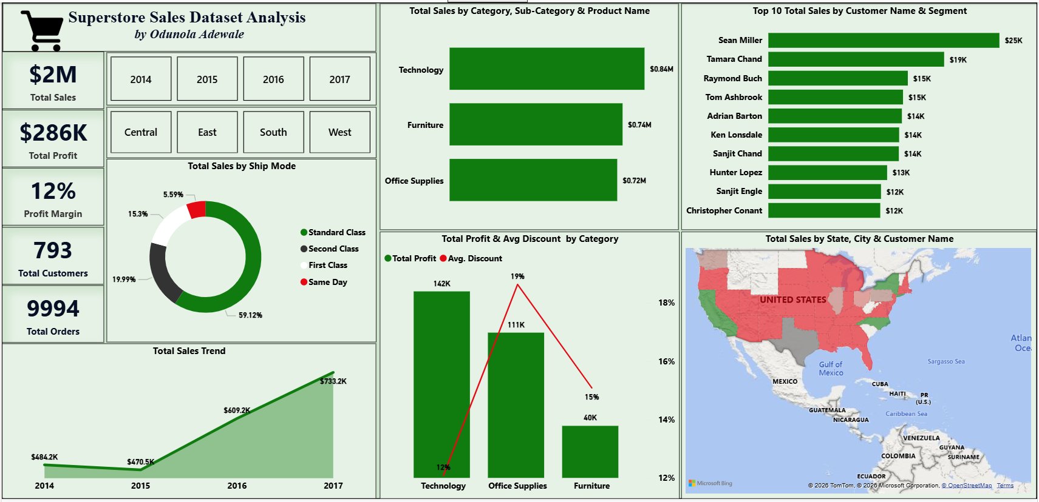
DASHBOARD SCREENSHOT

Slide 6
KEY INSIGHTS DISCOVERED
Category Performance: Technology generates the highest profit at $142K with only a 1% avg discount. Furniture is underperforming with $40K profit despite $0.74M in sales, and has the highest discount at 19%.
Discount Impact: Higher discounts correlate with lower profit margins. Office Supplies sits in the middle at 15% discount and $111K profit.
Geographic Issue: Most U.S. states show negative or low profit margins on the map. Only California and a few West Coast states are profitable. This suggests shipping costs, pricing, or discounting issues in the Central/East/South regions.
Sales Trend: Sales grew steadily from $470.5K in 2015 to $733.2K in 2017 after a dip in 2015.
Shipping: Standard Class dominates at 59.12% of orders, indicating customers prioritize cost over speed.
Top Customers: Sean Miller and Tamara Chand are the top 2 customers, contributing $44K combined. Retention of high-value customers is critical.

Slide 7
RECOMMENDATIONS
Focus more on high-performing categories such as technology to maximize revenue growth and profitability.
Review discount strategies on heavily discounted products such as tables, bookcases, and machines, as high discounts are reducing overall profit margins.
Improve sales performance in lower-performing regions such as the South Region (Texas, Florida, and North Carolina) and Central Region (Illinois and Ohio) through targeted marketing and operational improvements.
Strengthen customer retention programs for high-value customers contributing significantly to total sales revenue.

Slide 8
RECOMMENDATIONS CONTD.
Monitor yearly sales trends and seasonal demand patterns to improve forecasting and inventory planning.
Optimize pricing and discount policies to balance revenue growth with sustainable profitability.
Promote Standard Class. Since 59% of customers choose it, optimize logistics for this shipping mode to reduce costs.

Slide 9
CHALLENGES FACED
Initial confusion on whether the discount field was stored as a decimal or percentage, which caused formatting and interpretation issues during analysis.
Handling inconsistent formatting and ensuring data fields displayed correctly across visuals and calculations.
Learning and implementing drill-down functionality for the first time while ensuring it worked properly across visuals and hierarchy levels.
Selecting the most effective calculations and measures to compare sales, profit, discounts, and regional performance.
Balancing KPI calculations and supporting visuals to communicate insights clearly without overcrowding the dashboard.
Optimizing the map visualization to reduce clutter and improve color readability.

Slide 10
CONCLUSION
The analysis shows that the business is experiencing steady sales growth, but profitability remains a challenge outside the West region. Technology continues to be the strongest-performing category, while Furniture records weaker profit performance largely due to aggressive discounting strategies. Regional analysis also highlights areas where pricing and sales strategies need improvement to sustain long-term profitability.
By optimizing discount policies, improving regional pricing strategies, and focusing on high-performing products and customers, the company can improve profit margins without significantly affecting sales volume. The dashboard successfully transforms raw transactional data into clear and actionable insights, providing management with a fast and interactive way to monitor performance, identify problem areas, and support data-driven decision-making.

